Slide 1
Entering Database Systems
Intro to a Database using MS SQL Server

Slide 2
Entering Database Systems
Database Objects
What database objects will we work with:
Tables Stores data
Views Consolidates data from multiple sources
Stored Procs. Queries
Functions built in and user defined dB functions
Data Types built in and user defined dB types
Time permitting, I will add a couple more

Slide 3
Database Tables
Tables are used to store data in a database through a grid system of columns and rows
How to create a table through a script:
CREATE TABLE tblFriends (
friendId INT NOT NULL PRIMARY KEY IDENTITY,
fName NVARCHAR(MAX) NOT NULL DEFALUT '',
lName CHAR(500) NOT NULL DEFALUT '',
age INT NOT NULL DEFALUT 0,
phoneNum VARCHAR(20) NOT NULL DEFALUT 'NONE'
);
Lets review datatypes, NOT NULL, PRIMARY KEY, IDENTITY, and DEFAULT
Note that there are other options we will be adding as we move forward

Slide 4
Database Tables
The following are three ways we can enter data into our table (there are more as well)
Option 1: allow the table to generate its own friendId
INSERT INTO tblFriends (fName, lName, age, phoneNum)
VALUES ('Tom', 'Ryan', 25, '111-222-3333'),
('Sally', 'Right', 23, '222-333-4444'),
('Jack', 'Ryan', 24, '333-444-5555'),
('Mary', 'Light', 27, '')
Option 2: Insert your own friendId
SET IDENTITY_INSERT tblFriends ON
INSERT INTO tblFriend (friendId, fName, lName, age, phoneNum)
VALUES (1, 'Tom', 'Ryan', 25, '111-222-3333'),
(2, 'Sally', 'Right', 23, '222-333-4444'),
(7, 'Jack', 'Ryan', 24, '333-444-5555'),
(9, 'Mary', 'Light', 27, '')
SET IDENTITY_INSERT tblFriends OFF

Slide 5
Database Tables
The following are two ways we can enter data into our table (there are more as well)
Option 3: Add a mass amount of data at once using BULK INSERT
CREATE TABLE tblPersonalSavingsRates (
id INTIDENTITY PRIMARY KEY NOT NULL,
year INT NOT NULL,
rate FLOAT NOT NULL
);
BULK INSERT tblPersonalSavingsRates
FROM 'c:\temp\US_Personal_Savings_Rates_1960-2017.txt'
WITH (
FIRSTROW = 2,
ROWTERMINATOR = '\n',
FIELDTERMINATOR = '\t',
KEEPIDENTITY
)
FIRSTROW = What line the data starts on in the file. This is 1 based
ROWTERMINATOR = What character represents the end of the line character
FIELDTERMINATOR = The character that is used to separate fields in a line
KEEPIDENTITY = Used when file contains an ID field that needs to be imported

Slide 6
How do we set up tables in a database?
In order to set up a database we need to think about the following:
What data do we want to save?
How do we break up what we want to save into logical parts called tables?
How is data from separate tables related?
That’s pretty much about it… I mean, there are more things to consider but answering the above 3 questions will get you 90% of the way there.
So, lets consider a University system. What kind of data do you think we need to save? How would we break about the data into understandable and easy-to-use tables? How are tables related?
We can build an ER diagram in order to demonstrate the tables and the relationships between tables
Some Tables:
tblStudents, tblCourses, tblCourseSections, tblInstructors, tblCourseSectionInstructors, tblAssignments, tblCourseSectionAssignments, tblStudentCourseSectionAssignments, etc.
Notice the naming convention as well as how we will relate the various tables…

Slide 7
Some database rules to follow…
When setting up a dB there are a few “rules” you should stick by in order to assure a well structured base. Here are a couple of these rules – as we move through the semester you will learn more.
Most every table will have either a single INT or a UNIQUEIDENTIFIER field used for the identity. This field will (should) auto generate the value for the field. 99.99% of the time this is the only acceptable key field one should use for a table – NEVER use another system’s id field as your ID field. For example, you NEVER should use an email as a unique field value. You would NEVER use something like Miami’s unique ID (e.g., stahrm) as the field that is unique and shared within the dB (I’ll explain why). These fields should be “related” fields, but not the unique ID field. The key field should be named with something obvious like “studentId” or “courseSectionId”
Sometimes a table is simply made up of 2 key fields from other tables. For instance, say you have tables: student and courses. In order to know which student took which course you would need to have a 3rd table called something like “tblStudentCourseSections” with the fields “studentId” and “courseSectionId” (note: when we use the key field from one table in a different table for reference we call it a Foregin Key) so that we can associate a student with many course section records and a course with many student records. When this occurs we often mark the combination of both fields as the uniqueness – or the “key” fields for that table

Slide 8
Name your tables well. We use a prefix for all objects in our database.
Table tbl…
Stored Procedures sp…
Views vw…
Functions fn…
Lets jump in and start with a real database…
Download the create_ap.sql file from Canvas and save it to your temp or M: drive. It can be found in: Files/Databases/
In Visual Studio click the Open File icon on the top menu
Select the file (create_ap.sql)
Click the small green run arrow in the create_ap.sql tab and run it.
When asked to select a server expand Local and pick the MSSQLLocalDB and click Connect
Right click onto the Database folder and select Refresh to see that your new database
Lets take a look at the script…

Slide 9
Chapter 3
How to retrieve data from a single table

Slide 10
Objectives
Applied
Code and run SELECT statements that use any of the language elements presented in this chapter.
Knowledge
Distinguish between the base table values and the calculated values in SELECT statements.
Describe the use of a column alias.
Describe the order of precedence and the use of parentheses for arithmetic expressions.
Describe the use of the DISTINCT keyword and the TOP clause.
Describe the use of comparison operators, logical operators, and parentheses in WHERE clauses.

Slide 11
Objectives (cont.)
Knowledge
Describe the use of the IN, BETWEEN, and LIKE operators in WHERE clauses.
Describe the use of the IS NULL clause in a WHERE clause.
Describe the use of column names, aliases, calculated values, and column numbers in ORDER BY clauses.
Describe the use of the OFFSET and FETCH clauses in ORDER BY clauses.

Slide 12
The simplified syntax of the SELECT statement
SELECT select_list
FROM table_source [WHERE search_condition] [ORDER BY order_by_list]
The 4 clauses of the simplified SELECT statement
SELECT
FROM
WHERE
ORDER BY

Slide 13
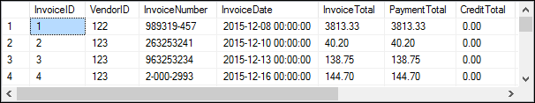
A simple SELECT statement
SELECT *
FROM Invoices;
(114 rows)

Slide 14

A SELECT statement that retrieves and sorts rows
SELECT InvoiceNumber, InvoiceDate, InvoiceTotal
FROM Invoices
ORDER BY InvoiceTotal;
(114 rows)

Slide 15
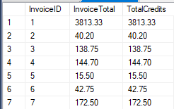

A SELECT statement that retrieves a calculated value
SELECT InvoiceID, InvoiceTotal, CreditTotal + PaymentTotal AS TotalCredits
FROM Invoices;
A SELECT statement that retrieves a calculated value for a single invoice
SELECT InvoiceID, InvoiceTotal, CreditTotal + PaymentTotal AS TotalCredits
FROM Invoices
WHERE InvoiceID = 17;

Slide 16
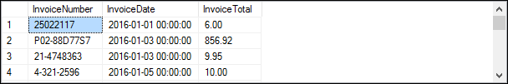
A SELECT statement that retrieves all invoices between given dates
SELECT InvoiceNumber, InvoiceDate, InvoiceTotal
FROM Invoices
WHERE InvoiceDate BETWEEN '2016-01-01' AND '2016-05-31'
ORDER BY InvoiceDate;
(101 rows)

Slide 17
A SELECT statement that returns an empty result set
SELECT InvoiceNumber, InvoiceDate, InvoiceTotal
FROM Invoices
WHERE InvoiceTotal > 50000;

Slide 18
The expanded syntax of the SELECT clause
SELECT [ALL|DISTINCT] [TOP n [PERCENT] [WITH TIES]]
column_specification [[AS] result_column]
[, column_specification [[AS] result_column]] ...
Five ways to code column specifications
All columns in a base table
Column name in a base table
Arithmetic expression
String expression
Function

Slide 19
Column specifications that use base table values
The * is used to retrieve all columns
SELECT *
Column names are used to retrieve specific columns
SELECT VendorName, VendorCity, VendorState

Slide 20
Column specifications that use calculated values
An arithmetic expression is used to calculate BalanceDue
SELECT InvoiceNumber, InvoiceTotal - PaymentTotal – CreditTotalAS BalanceDue;
A string expression is used to calculate FullName
SELECT VendorContactFName + ' ' + VendorContactLName AS FullName;
A function is used to calculate CurrentDate
SELECT InvoiceNumber, InvoiceDate, GETDATE() AS CurrentDate;

Slide 21
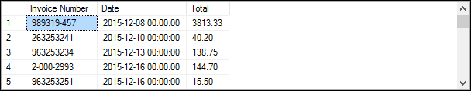
Two ways to name the columns in a result set
Using the AS keyword (the preferred technique)
SELECT InvoiceNumber AS [Invoice Number],
InvoiceDate AS Date, InvoiceTotal AS Total
FROM Invoices;
Using the equal operator (an older technique)
SELECT [Invoice Number] = InvoiceNumber,
Date = InvoiceDate,
Total = InvoiceTotal
FROM Invoices;
The result set for both SELECT statements
Don’t do this! Column names should not have spaces. Poor practice

Slide 22
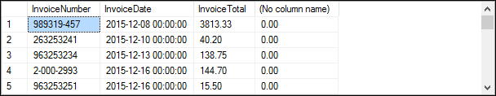
A SELECT statement that doesn’t name a calculated column
SELECT InvoiceNumber, InvoiceDate, InvoiceTotal,
InvoiceTotal - PaymentTotal - CreditTotal
FROM Invoices;

Slide 23

How to concatenate string data
SELECT VendorCity, VendorState, VendorCity + VendorState
FROM Vendors;

Slide 24
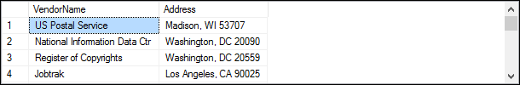
How to format string data using literal values
SELECT VendorName,
VendorCity + ', ' + VendorState + ' ' + VendorZipCode
AS Address
FROM Vendors;

Slide 25
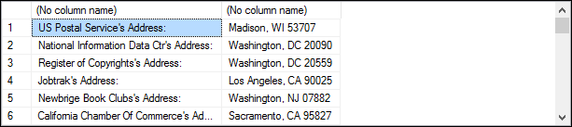
How to include apostrophes in literal values
SELECT VendorName + '''s Address: ',
VendorCity + ', ' + VendorState + ' ' + VendorZipCode
FROM Vendors;

Slide 26
The arithmetic operators in order of precedence
* Multiplication
/ Division
% Modulo (Remainder)
+ Addition
- Subtraction

Slide 27

A SELECT statement that calculates the balance due
SELECT InvoiceTotal,
PaymentTotal,
CreditTotal,
InvoiceTotal - PaymentTotal - CreditTotal AS BalanceDue
FROM Invoices;

Slide 28


Slide 29


Slide 31


Slide 33


Slide 35
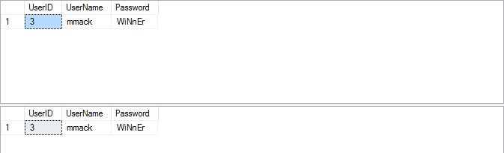

Slide 36
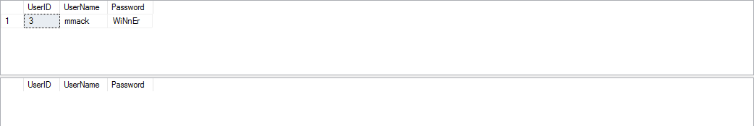

Slide 38
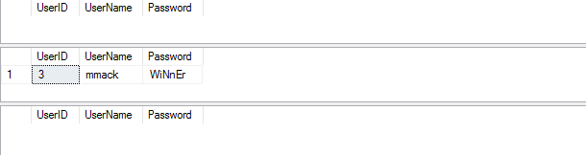

Slide 39


Slide 41
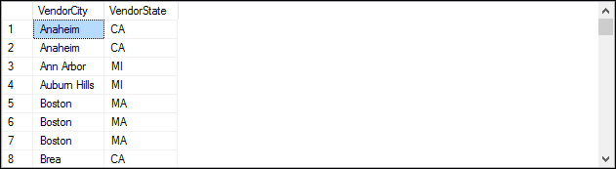

Slide 42
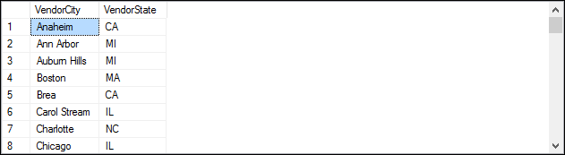

Slide 43


Slide 44


Slide 45
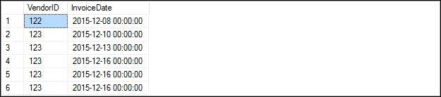

Slide 49
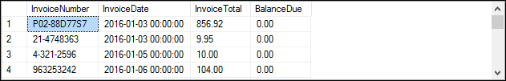

Slide 50
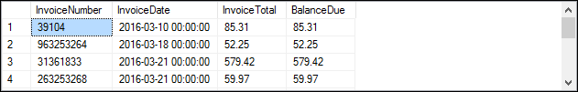

Slide 53
Warning about date comparisons
All columns that have the datetime data type include both a date and time, and so does the value returned by the GetDate() function.
When you code a date literal without a time, the time defaults to 12:00 AM (midnight). As a result, a date comparison may not yield the results you expect.
Note: Using functions like CONVERT() and CAST() when dealing with dates work just fine but are still functions and will always be slower to process than Boolean expressions. So, if you are working with date fields that contain a time element you are better off using the following form:
SELECT fields WHERE dateField >= 'from date‘ AND < 'to date + 1 day‘
Example: return all columns from Invoices where InvoiceDueDate is 1/1/2018
SELECT *
FROM Invoices
WHERE InvoiceDueDate >= '1/1/2018' AND InvoiceDate < '1/2/2018'

Slide 58
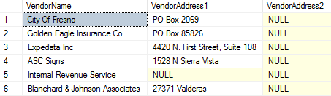

Slide 60
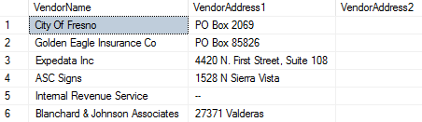

Slide 61
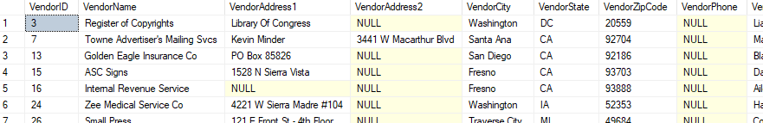

Slide 62


Slide 63


Slide 64
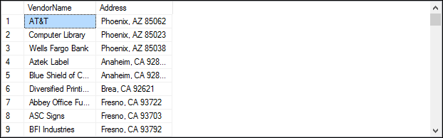

Slide 65


Slide 66


Slide 67


Slide 69


Slide 70
